Slide 1
Computer Networks

Slide 2
Computer Networks

Slide 3
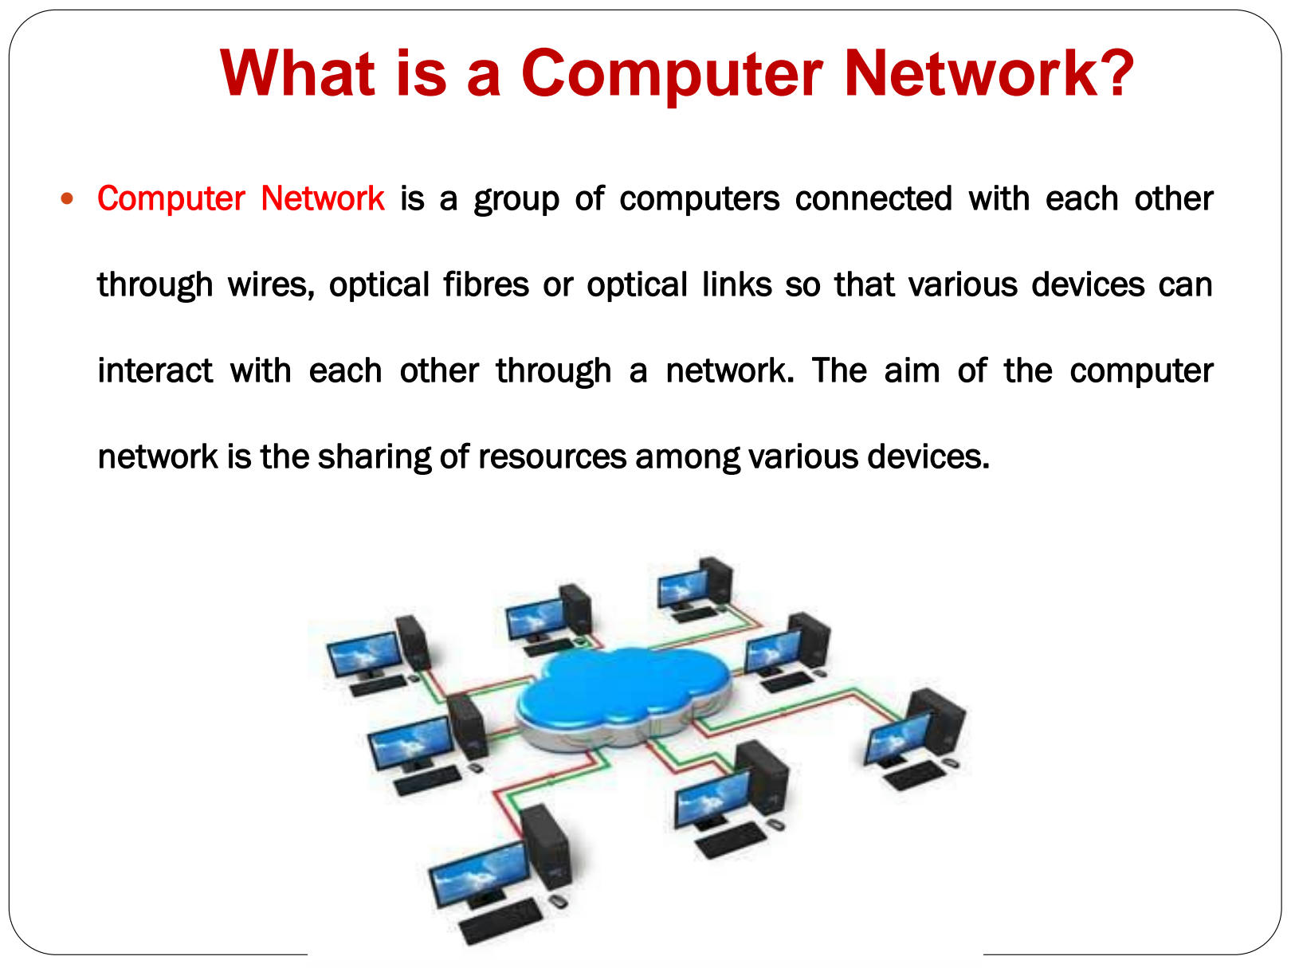
Introduction to Computer Networks
Computer networks are systems of interconnected devices that can communicate and share resources.
Networks can be classified based on their geographical scope, such as LANs (Local Area Networks) and WANs (Wide Area Networks).
The Internet is a global network of networks that connects billions of devices worldwide.

Slide 4
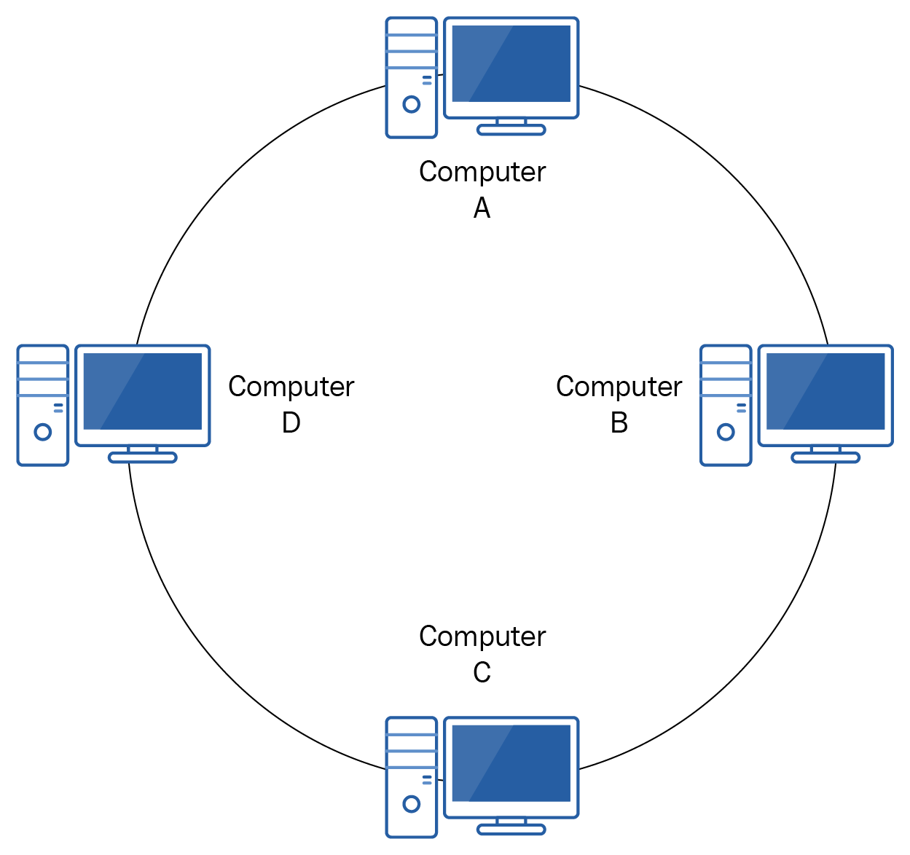
Network Topologies
Network topology refers to the physical or logical layout of devices in a network.
Common topologies include bus, ring, star, mesh, and hybrid configurations.
Each topology has its own advantages and disadvantages in terms of cost, scalability, and fault tolerance.

Slide 5
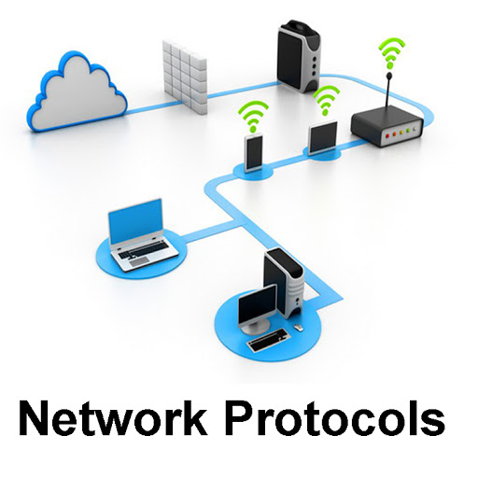
Network Protocols
Network protocols are standardized rules that govern communication between devices on a network.
Examples of protocols include TCP/IP, HTTP, and SMTP.
Protocols ensure that data is transmitted reliably and efficiently across the network.

Slide 6
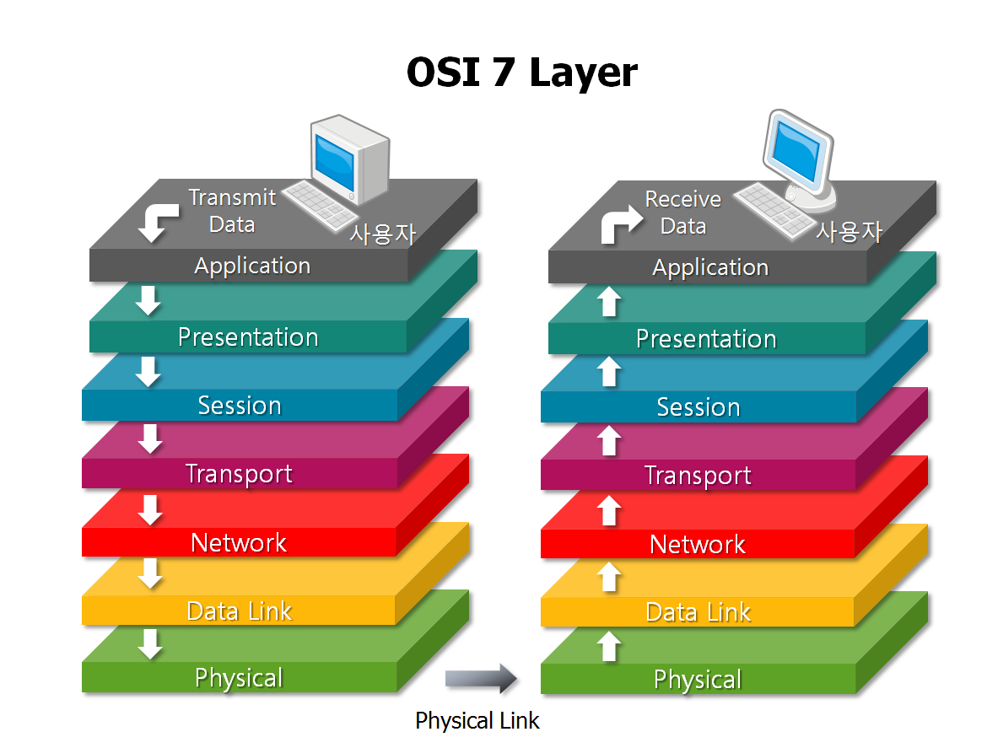
OSI Model
The OSI (Open Systems Interconnection) model is a conceptual framework that standardizes the functions of a network into seven layers.
Each layer has specific responsibilities, such as data encapsulation, routing, and error detection.
Understanding the OSI model helps in troubleshooting network issues and designing scalable networks.

Slide 7
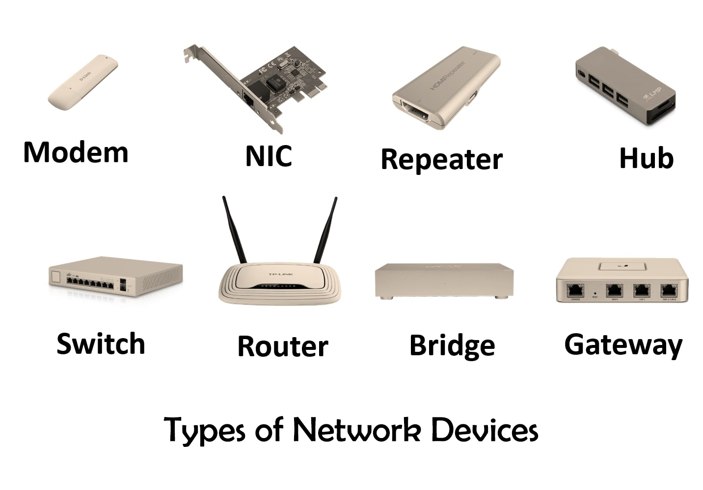
Network Devices
Network devices include routers, switches, hubs, and access points.
Routers facilitate communication between different networks.
Switches connect devices within a network and manage traffic efficiently.

Slide 8
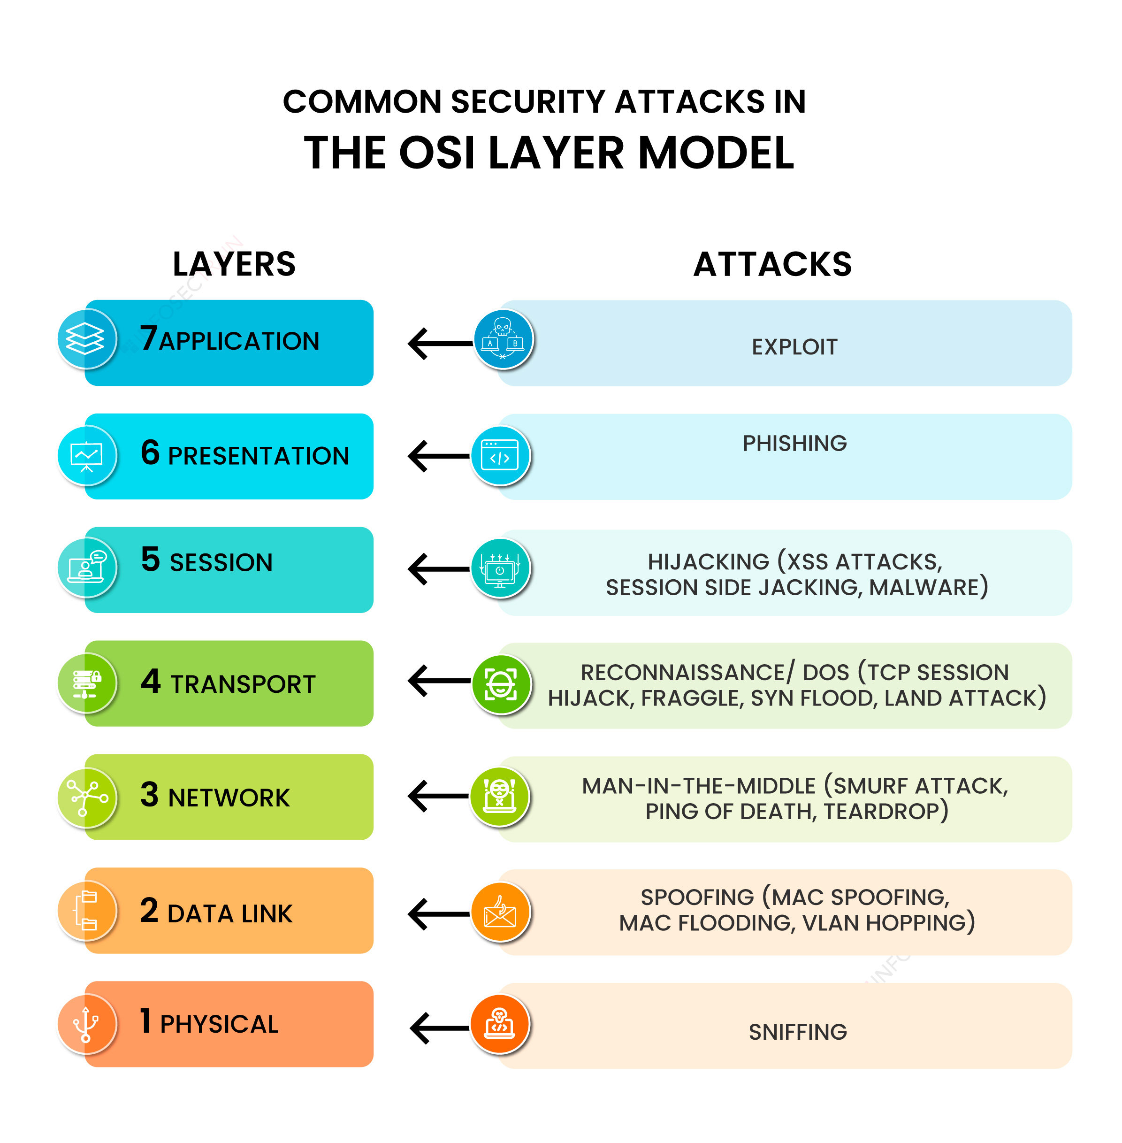
Network Security
Network security encompasses measures to protect data and resources from unauthorized access or attacks.
Common security measures include firewalls, encryption, and access control lists.
Regular security audits and updates are essential to maintain the integrity of a network.

Slide 9
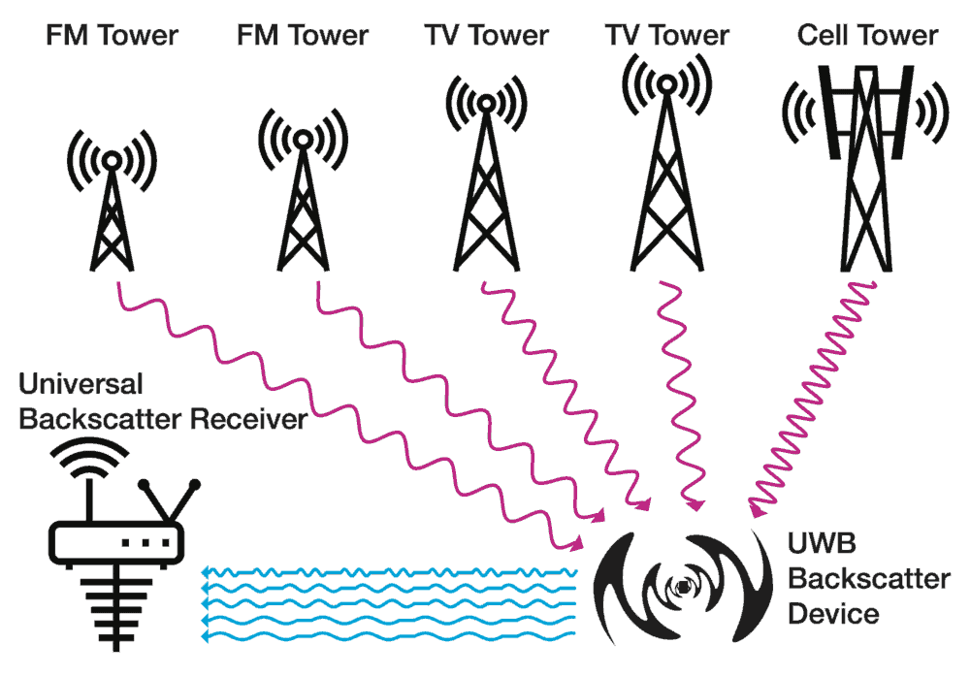
Wireless Networks
Wireless networks use radio waves to transmit data between devices.
Wi-Fi is a common wireless networking technology that enables connectivity without physical cables.
Security protocols like WPA2 and WPA3 are used to secure wireless networks from unauthorized access.

Slide 10
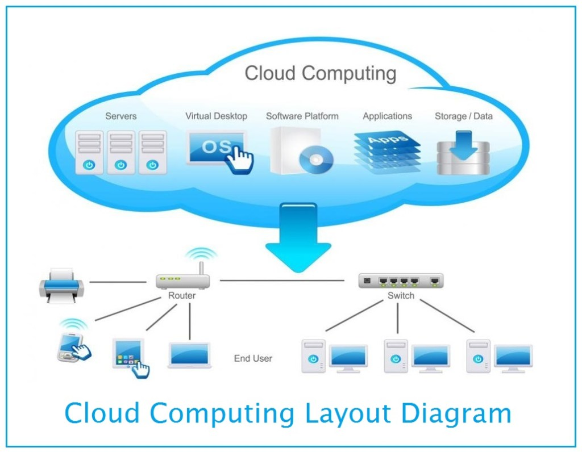
Cloud Computing and Networks
Cloud computing relies on network infrastructure to deliver services over the internet.
Cloud networks provide scalability, flexibility, and cost-efficiency for businesses.
Virtual private networks (VPNs) are used to securely connect to cloud services over the internet.

Slide 11

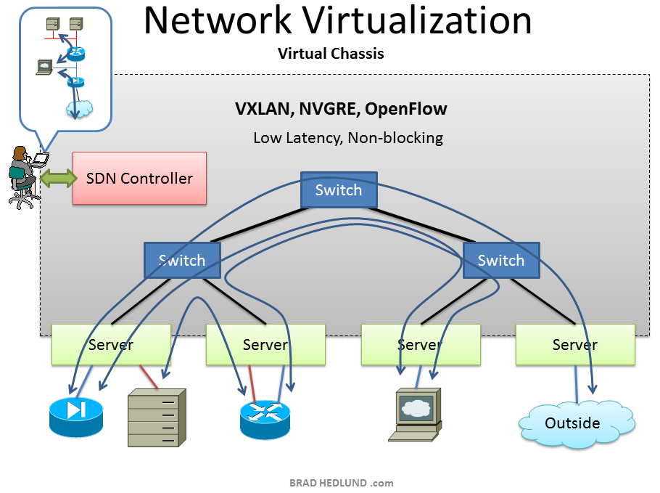
Network Virtualization
Network virtualization enables the creation of multiple virtual networks on a single physical network infrastructure.
Virtual networks can be customized to meet specific requirements without the need for additional hardware.
Software-defined networking (SDN) is a key technology that facilitates network virtualization and automation.

Slide 12
Future Trends in Computer Networks
Emerging technologies like 5G, Internet of Things (IoT), and edge computing are shaping the future of computer networks.
5G networks promise faster speeds and lower latency for mobile devices.
IoT devices are driving the need for secure and scalable networks to support the growing number of connected devices.

Slide 13
References
Forouzan, B. A. (2013). Data communications and networking. McGraw-Hill Education.
Kurose, J. F., & Ross, K. W. (2017). Computer networking: a top-down approach. Pearson.
Tanenbaum, A. S., & Wetherall, D. J. (2018). Computer networks. Pearson.

